Slide 1

Prof. Jonathan Chase
Advanced Community Ecology Course at Peking University
Lecture 5: Other ‘diversities’: Phylogenetic and Functional

Slide 2

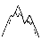









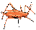


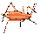




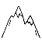


Organism/individual
Fitness
Behavior
Physiology
Etcetera
Population/ Metapopulation
Abundance
Growth/dynamics
Distribution
Time
Energy, Nutrients, water
Community/Metacommunity
Coexistence/Assembly
Richness/diversity/Evenness
Scale and Beta-Diversity
Change through time (stability)
Food Webs and trophic structure (also mutualisms)
Biodiversity and ecosystem functioning (BEF)
Ecosystem fluxes and cycles
Energy, Nutrients, water

Slide 3
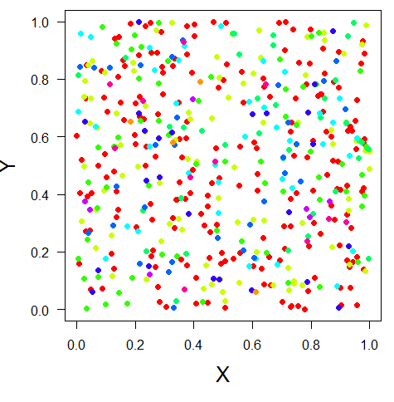
Any measure of diversity only captures part of the picture
α, richness, evenness, diversity entropy
β, similarity, distance decay
γ, SAR, EAR, etc

Slide 4
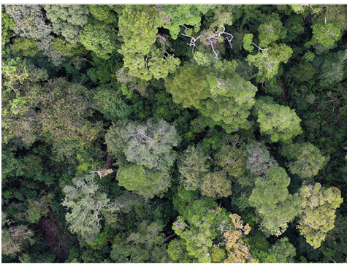
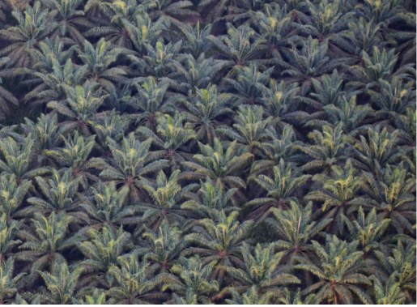

Slide 5
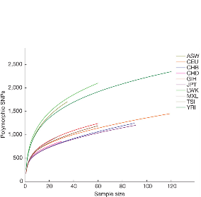
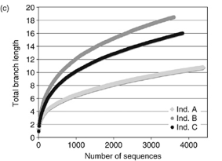
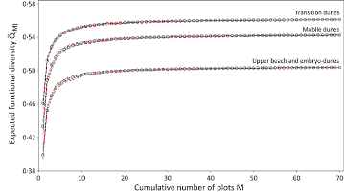
What about other biodiversity facets?
Genetic diversity
Phylogenetic diversity
Functional diversity

Slide 6
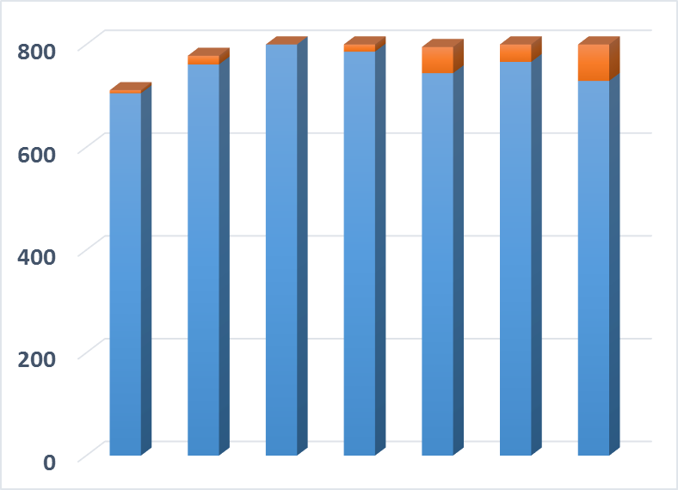
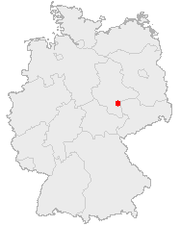
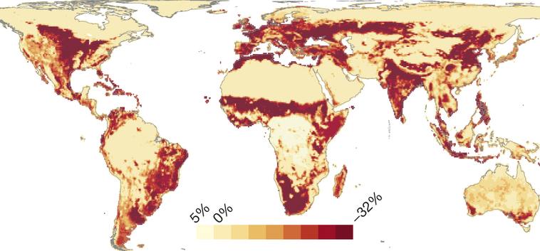
Is there biodiversity loss at smaller scales??
Number of Species
Public Domain, https://commons.wikimedia.org/w/index.php?curid=362363
~1700
1850
1950
~Today
Year
Data from: Knapp, S., et al. 2016. Increasing species richness but decreasing phylogenetic richness and divergence over a 320‐year period of urbanization. Journal of Applied Ecology. doi:10.1111/1365-2664.12826
Reprinted by permission from Macmillan Publishers Ltd: Newbold, T., et al. 2015. Global effects of land use on local terrestrial biodiversity. Nature, 520: 45-50.

Slide 7
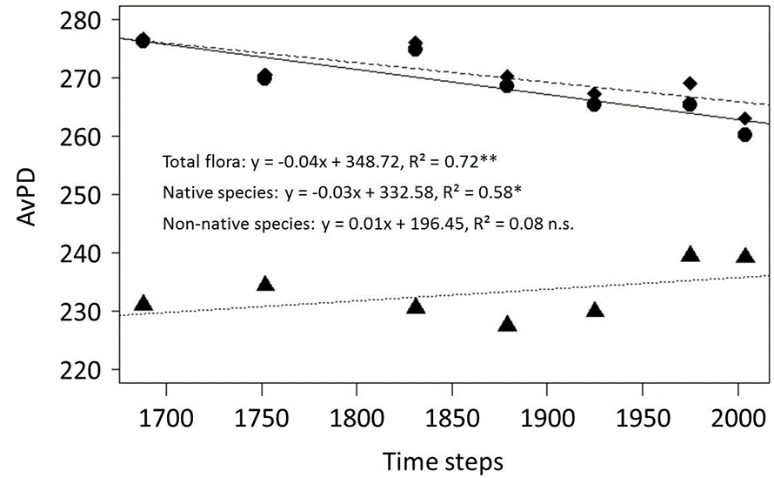
Phylogenetic Diversity
Knapp et al. 2017

Slide 8
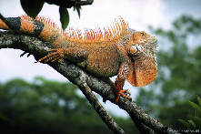
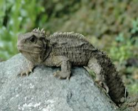
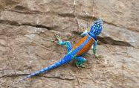
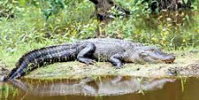
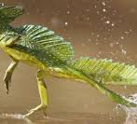
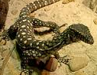
Which community is more diverse?

Slide 9
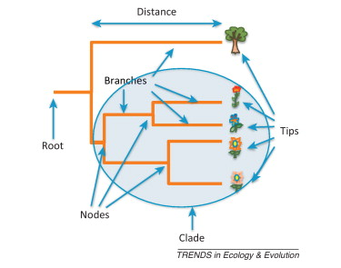
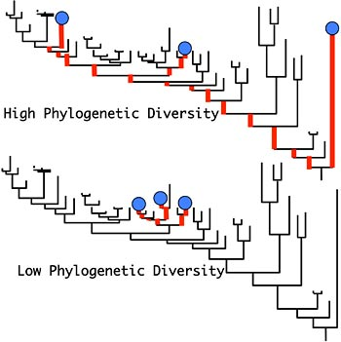
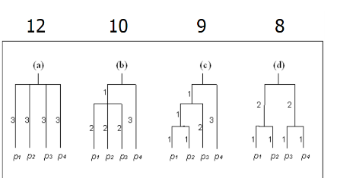
Phylodiversity=sum of branch lengths (Faith 2002)

Slide 10
Metric Choice for Phylogenetic Diversity Matters
Tucker et al. 2016

Slide 11
Tucker et al. 2016

Slide 12
Two main uses of phylogenetic diversity measures
Explore evolutionary patterns (sometimes in the context of conservation)
As ‘proxy’ for niche similarity ideas (e.g., phylogeny ~ function)

Slide 13
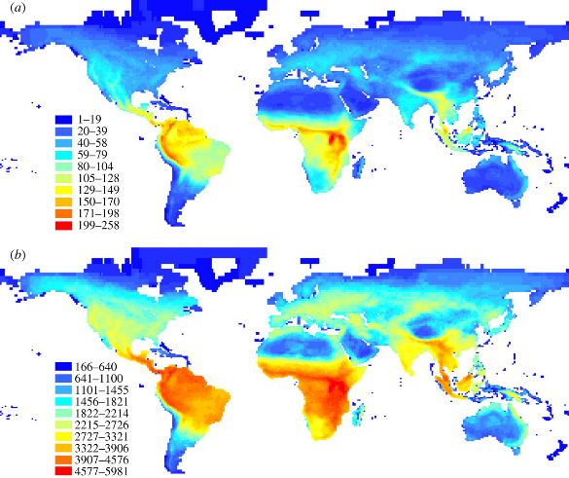
Mammals
—taxonomic diversity
--Phylogenetic
diversity
Davies and Buckley 2011

Slide 14
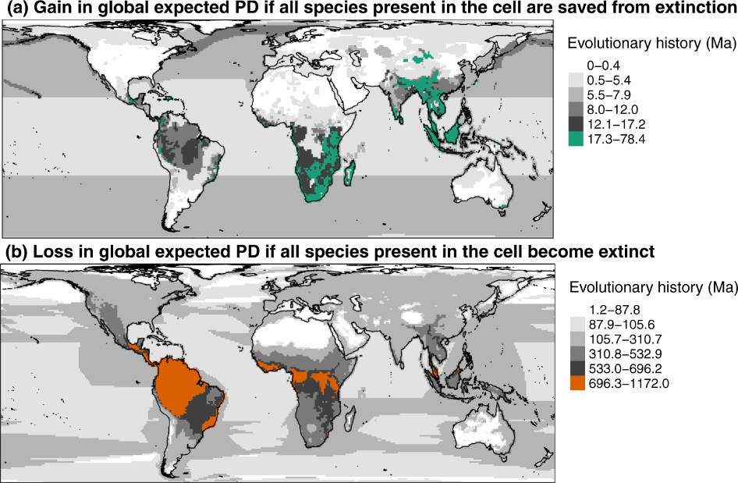
Robuchon et al. 2021 Nature Communications

Slide 15
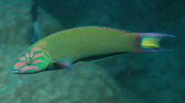
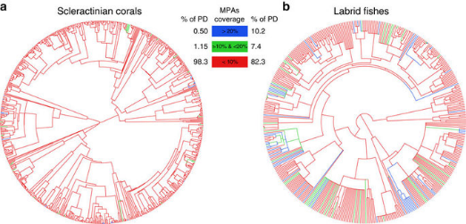
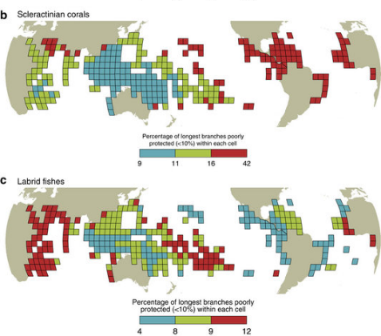
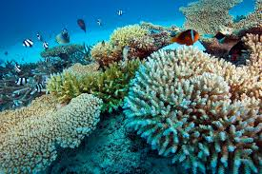
Mouillot et al. 2016

Slide 16
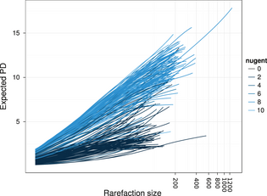
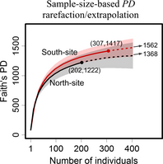
Rarefaction for Phylogenetic Diversity
Nipperess and Matsen 2013
Chao et al. 2015

Slide 17
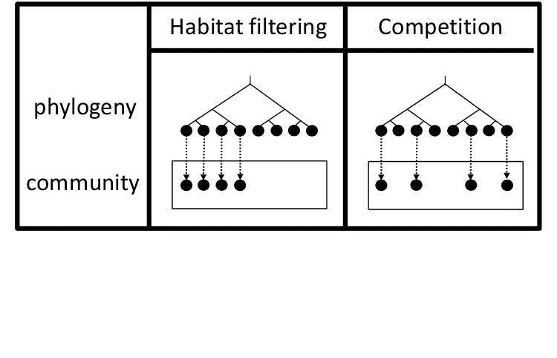
Sometimes we assume phylogeny→trait→interactions….

Slide 18
Over versus under dispersion….

Slide 19
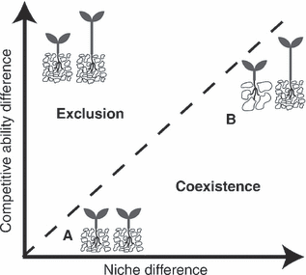
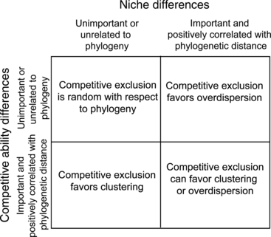
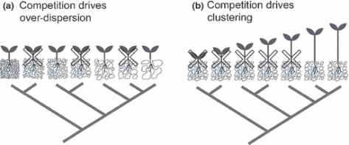
Phylogenetic Coexistence—What Does Theory Predict?
Mayfield and Levine 2010, Ecology Letters

Slide 20
More phylogenetically distant species not more likely to coexist…
…but traits are a better indicator…
Narwani et al. 2013

Slide 21
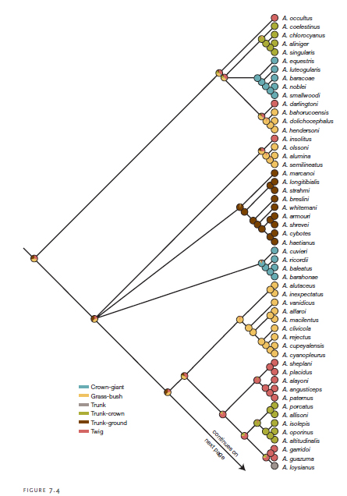
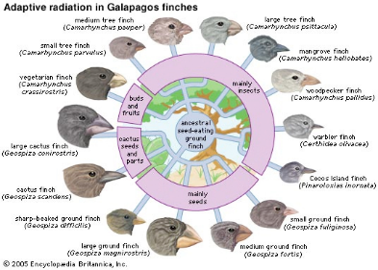
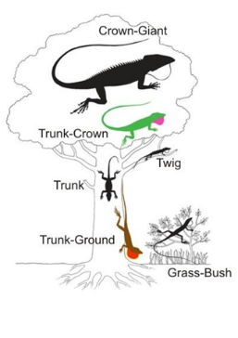
Correlation between traits and phylogenies?
Losos 2005

Slide 22
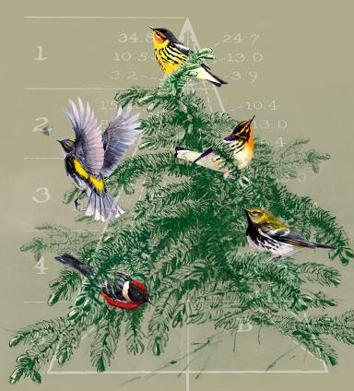
Ecological Niches as the Basis for Coexistence/Diversity
Limiting Similarity (Hutchinsonian ratios)
--Hutchinson 1959
Competition and coexistence
--MacArthur (1958)

Slide 23
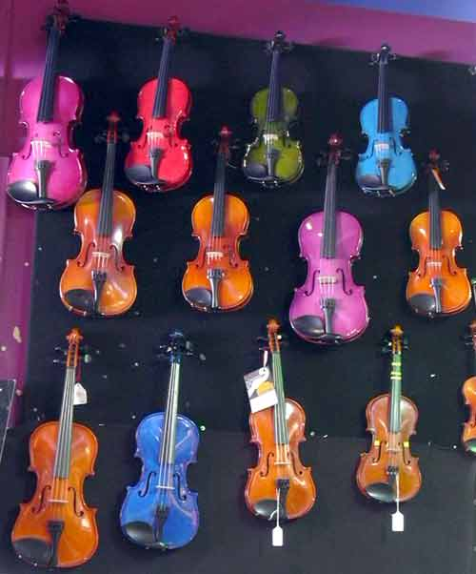
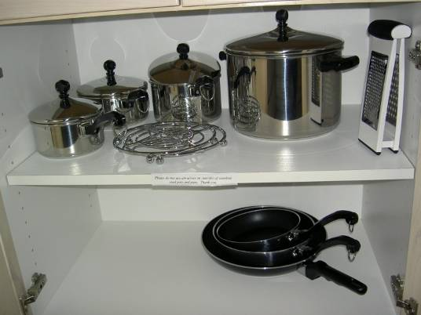

Slide 24
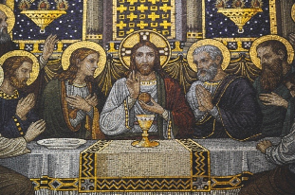
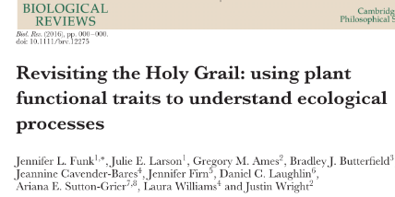

Slide 25
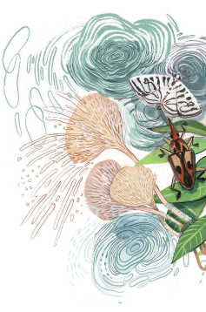
Functional ecology
“Function” (the action of performing)
Relates to the role of organisms in their environment.
Reflects natural selection (environmental filters or competition) on an organism.
“Function” specific activity carried out by part of a whole or by the whole itself, e.g., species and ecosystems (scale).
Calow 1987 Func. Ecol; Garnier et al 2016
Elizabeth Builes

Slide 26
Functional diversity: the variation of traits between organisms that can be used to address ecological questions.
E.g., leaf size, body size.
Elizabeth Builes
Dı́az & Cabido 2001 Trends Ecol. Evol.; Mason et al 2005 Oikos

Slide 27
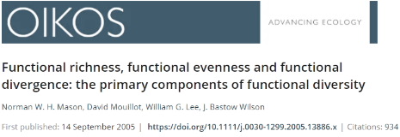
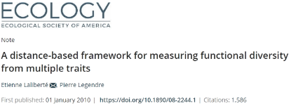

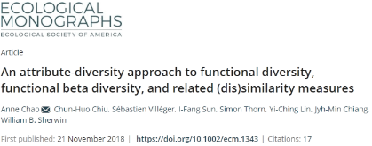
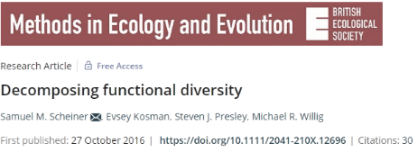
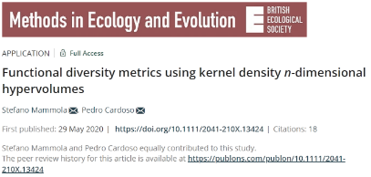
Methods

Slide 28
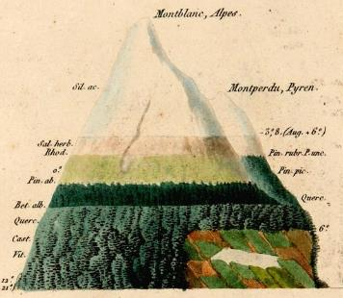
Trait-based functional ecology
‘Schimper world (1898)’
Certain species are more successful in different parts of the landscape than other because their attributes “traits”.
Climate and environmental attributes filter species based on their traits.
Westoby & Wright 2006
A. von Humboldt
Notes:
How come ecologist and biologist started thinking about functional diversity?
German Botanist Andreas Schimper (Pflanzengeographie auf Physiologischer Grundlage 1898) from the 18 hundreds.
In his world, some plant species are more successful in different parts of the landscape, and this is because they have different quantitative characteristics, such as leaf nitrogen concentrations, rooting depths, wood densities, leaf sizes and canopy heights. Schimper world is set in real physical geography, along gradients of rainfall, temperature, and geomorphology.
Plant stems, canopy architecture, foliage are so influential in terrestrial ecosystems that Schimper world should be important for any ecologist.

Slide 29


Functional traits
Examples
Plant stature
Seed mass
Leaf area
Pollination syndrome (categorical)
Body size
Beak length
Wing length
Diet (categorical)
$$\sim Ecological Functions (e.g., fitness)$$

Slide 30


The plant 2D – trait space
The avian 3D - trait space
Díaz et al. 2016. Nature.
Pigot et al 2020. Nature Ecology & Evolution.

Slide 31

Jeliaskov and Chase (unpublished)

Slide 32


Sometimes Taxonomic and Functional Change in the same direction

Slide 33












Sometimes change in the opposite direction
(Not always loss of Functional [or Phylogenetic] Diversity)

Slide 34




Slide 35




Slide 36

(at least) Two kinds of scale matter….
Weiher and Keddy 1995, Swenson et al. 2007

Slide 37

Functional diversity rarefaction curves…
How might number of traits that go into this matter?
Ricotta et al. 2012

Slide 38

Comparing diversity-area relationships in forest plots….
Wang et al. 2013

Slide 39


Roles of Traits in Ecosystem Functions?

Slide 40
10 minute break

